Slide 1

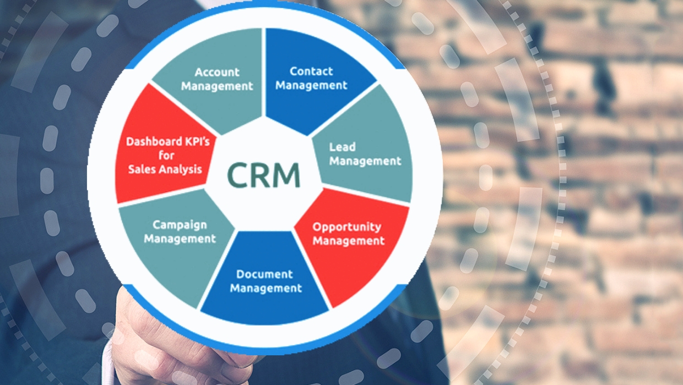
CRM SALESFORCE
PROJECT P(113)
Group 5
TEAM MEMBERS:
Ms. Sampada Shailesh Bhavsar
Mr. Pramod Ramesh Rajbhoj
Mr. Mohamed Jaffar Niyaz
Mr. Shashikanth
Mr. Vinay Ramnath yadav
Ms. Shama Patil
Ms. Mansi Arun Nagpure
Mentor Name : Mr. Mahendra Singh

Slide 2
Business Objective
Improve the buyer’s journey
Improve operational efficiency
Increase customer retention
Lower your customer acquisition cost
Generate more sales

Slide 3
What is CRM?
CRM (Customer Relationship Management) helps you keep track of everything about your customers and your potential customers so you can build great relationships with them.
Customer relationship management (CRM) software offers tools and capabilities to manage a business’s lead pipeline and customer journey efficiently.
A CRM system centralizes all your important customer and company data in one place, so your marketing, sales, commerce, service, and IT teams have the right information to deliver the easy, connected experiences customers expect.
CRM helps businesses unite everyone with one shared goal: keep your customers happy.

Slide 4
CRM Process
1. Reach
2. Acquisition
3. Conversion
4. Retention
5.Loyalty
(Marketing)
(Customer Service)
(Sales)

Slide 5
How CRMs work ?
First, a CRM automates lead and customer data collection. Such data can include where they are in the customer journey, the channels they use to interact with or share opinions about your brand, their preferences, interaction and purchase history with your company, demographics and more.
For each lead, this data is made available across sales, marketing and customer service. This allows all company functions to offer a seamless journey from lead development to customer retention. For example, if marketing learns a warm lead prefers a certain product line, once a hot lead, sales can reach out for a conversation focused on that product line. Automated tasks can alert sales reps when leads are hot and it is time to reach out.
Once collected, your CRM begins to also track the data within it on a large-overview scale. It can, for example, track leads from acquisition to closing, conversion rates, customer retention, sales forecasts and customer turnover. Then, analytics tools within your CRM software create real-time reports on overall trends. In doing so, you learn what your company is doing well and areas that are ripe for improvement across your customer journey.

Slide 6
KPIs for Opportunity
Expected Amount
Active Opportunities
Conversion Rate
Win Rate
Loss
Trend Analysis
Running Total Expected Vs Commit Forecast Amount over Time
Running Total Active Vs Total Opportunities over Time
Closed Won Vs Total Opportunities over Time
Closed Won vs Total Closed over Time
Expected Amount by Opportunity Type
Opportunities by Industry

Slide 7
KPIs for Lead
Total Lead
Expected Amount from Converted Leads
Conversion Rate
Converted Accounts
Converted Opportunities
Lead By Source
Lead By industry

Slide 8
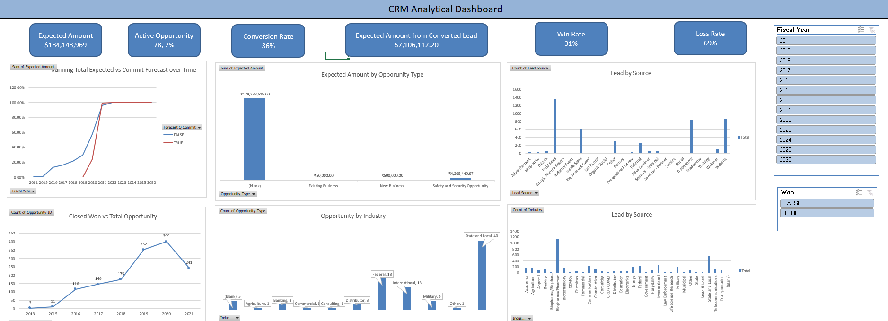
Excel Dashboard for Opportunity

Slide 9
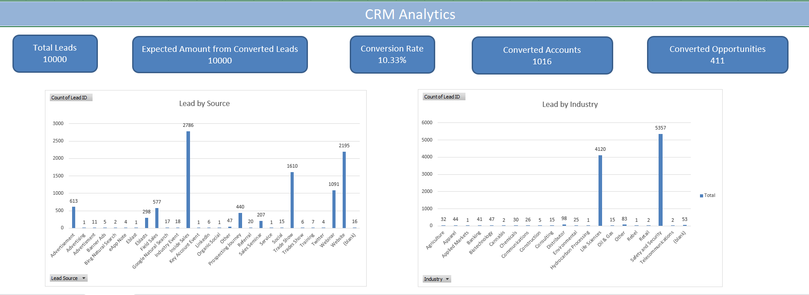
Excel Dashboard for Lead

Slide 10
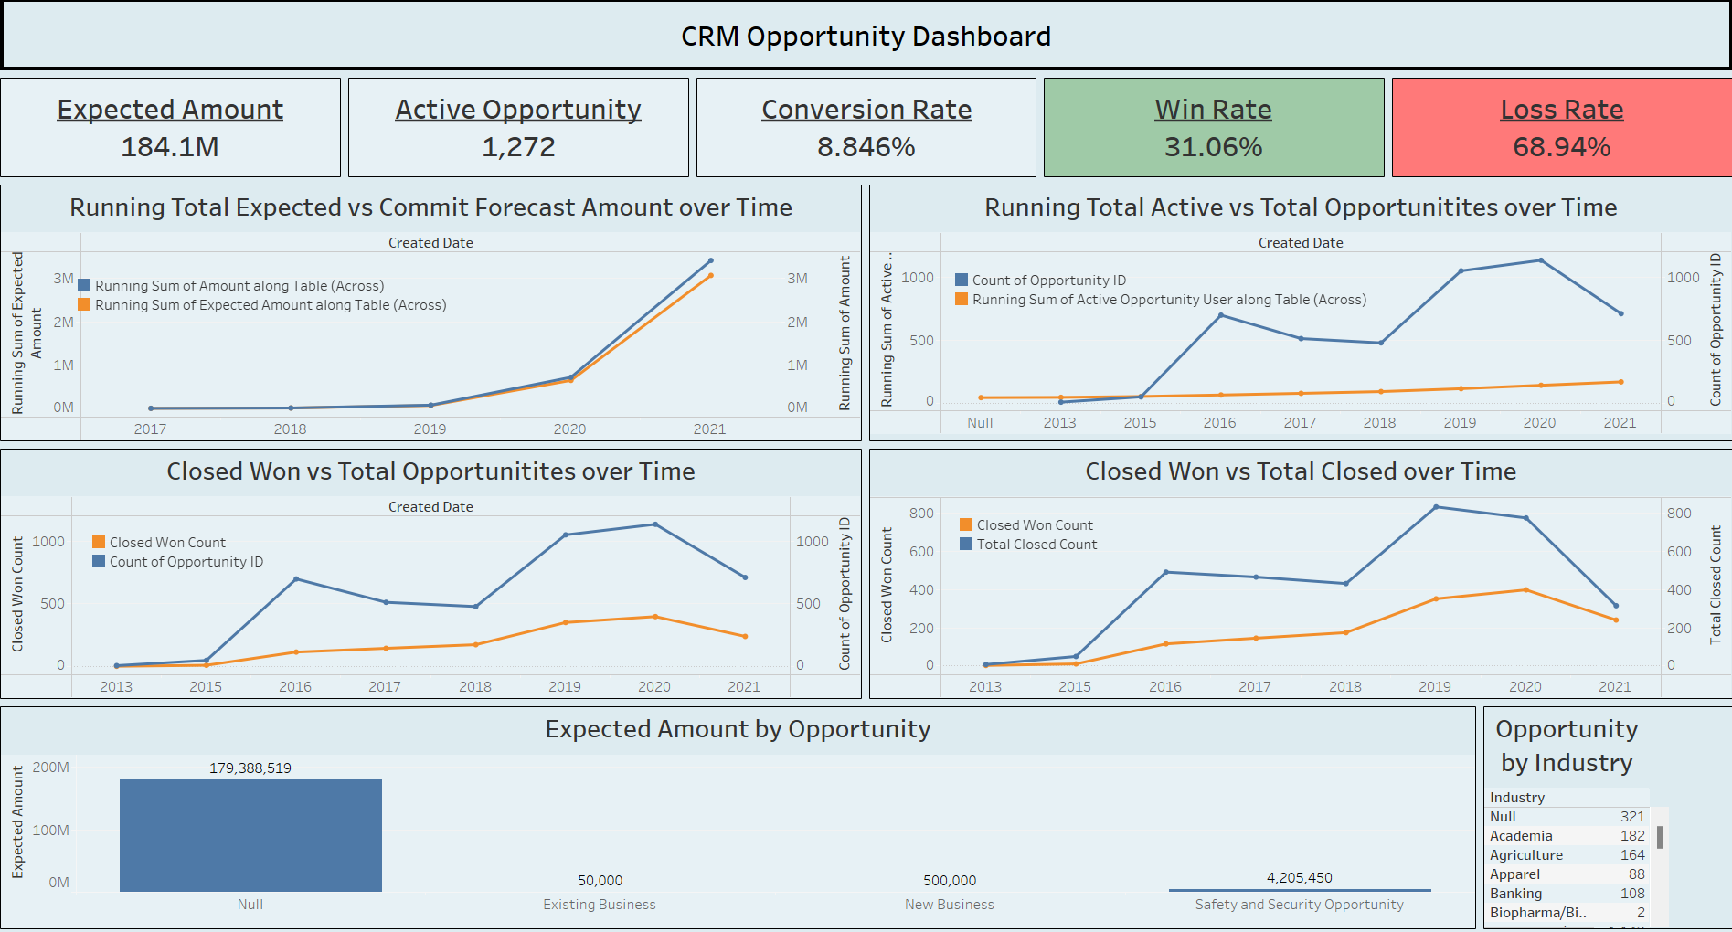
Tableau Dashboard for Opportunity

Slide 11
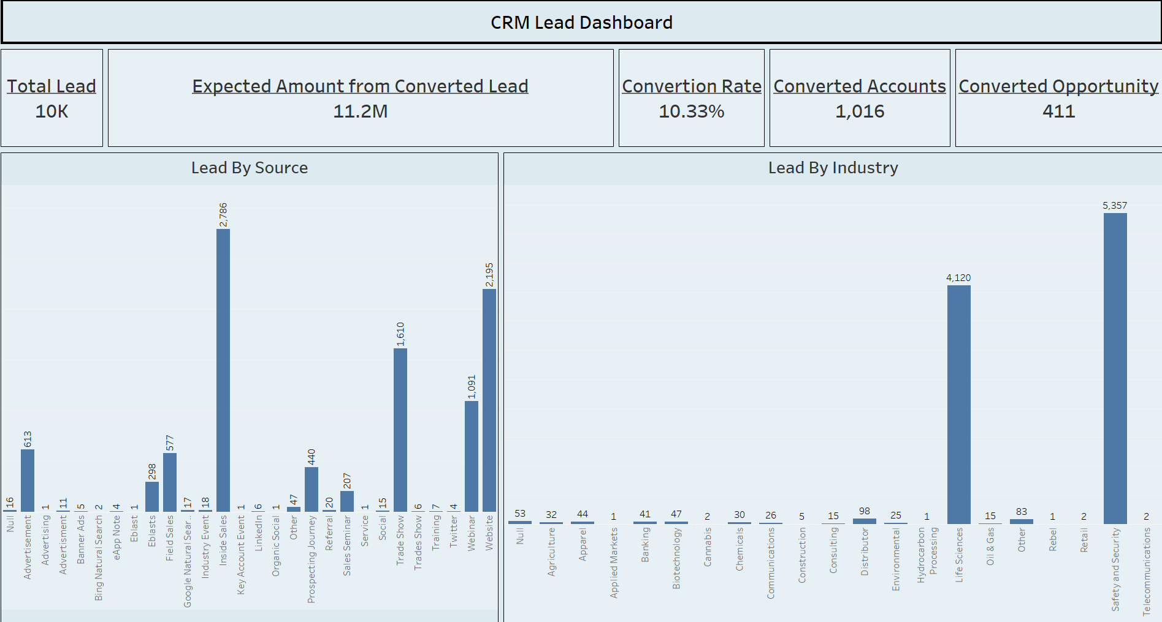
Tableau Dashboard for Lead

Slide 12
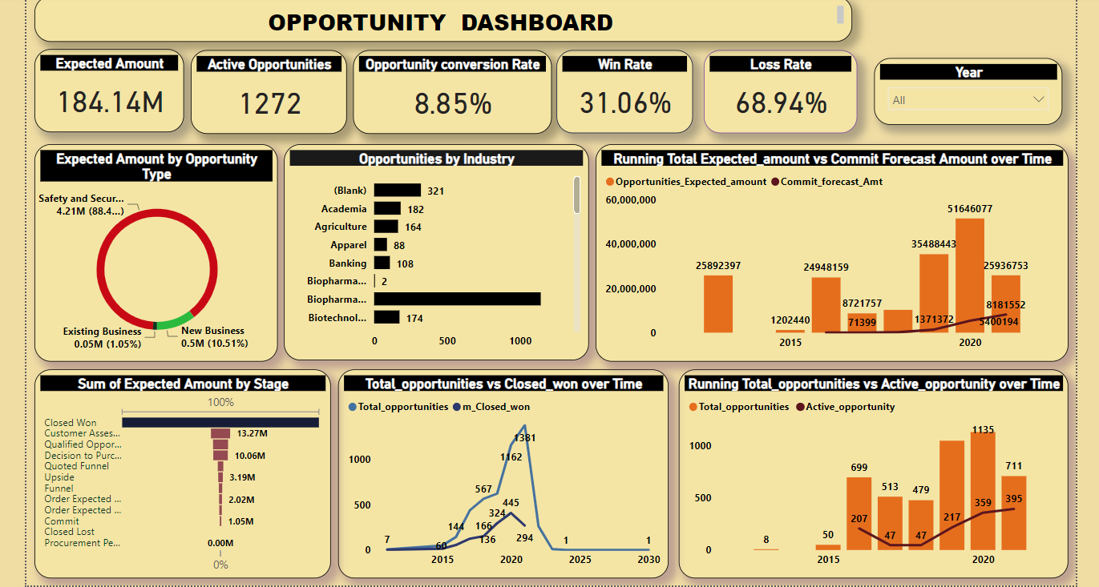
Power BI Dashboard for Opportunity

Slide 13
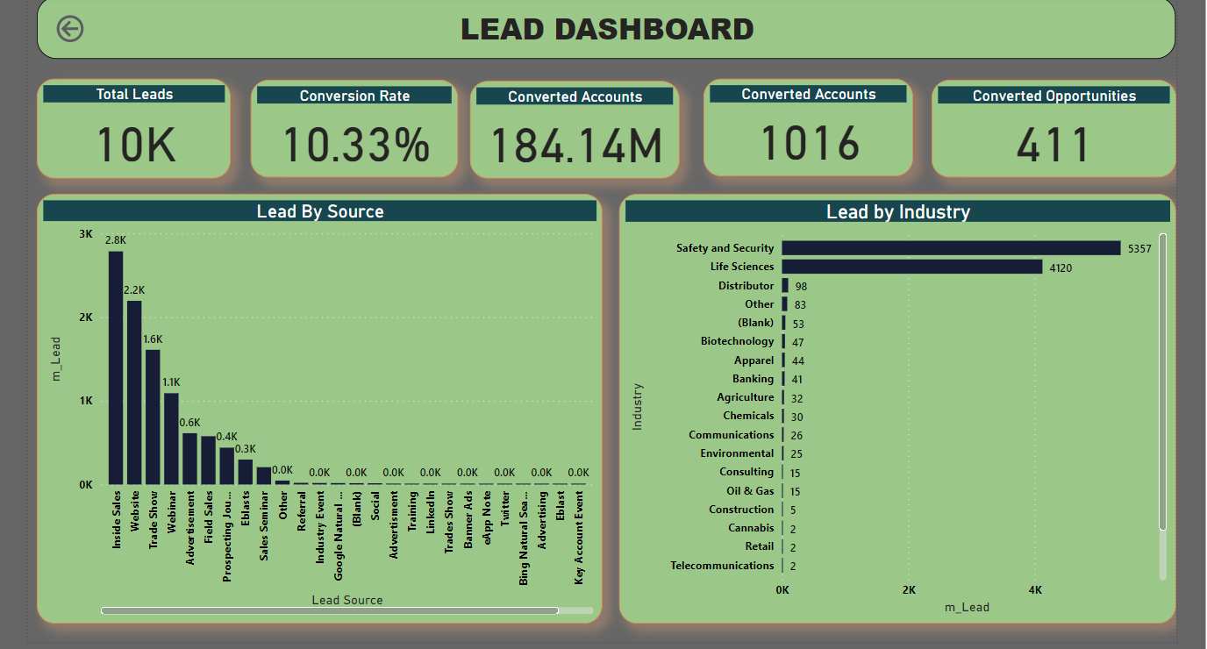
Power BI Dashboard for Lead

Slide 14

Thank You…!!!

